Slide 1
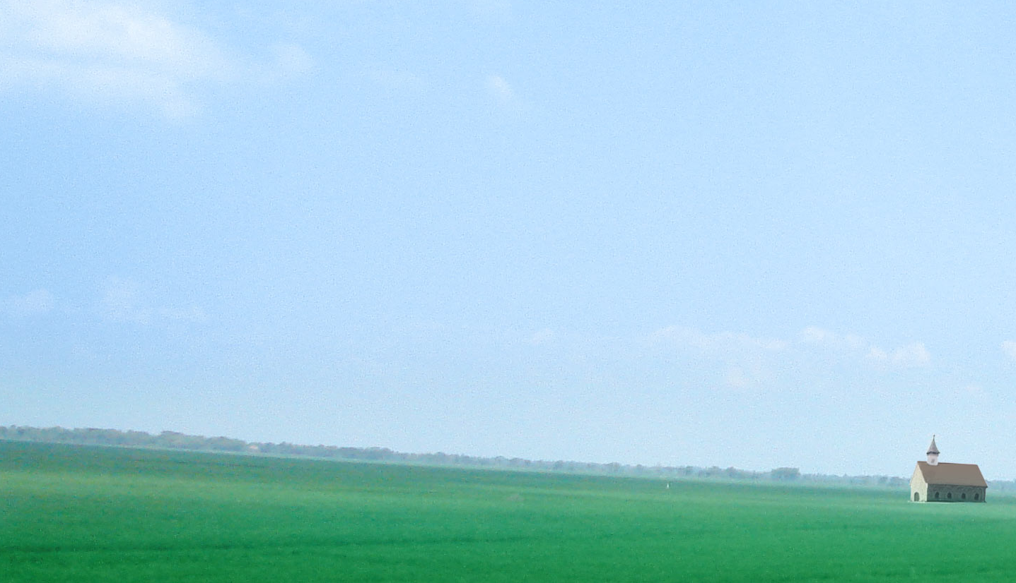
Jacob: The Earnest Prayer
26/7/2026
Pastor: Kuy Hee Han

Slide 2
Have you ever tried making pottery? The most important step when making pottery is preparing good clay. If even a single small stone gets into the clay, the pottery will crack when fired at high temperatures.

Slide 3
Hence the first step to this work is to dissolve the clay in water to make a thin clay slip. Then, you pour the clay slip onto a sieve with a very fine mesh.

Slide 4
Impurities ranging from finger-sized pebbles to invisible grains of sand and twigs are filtered out and remain on the sieve.

Slide 5
The potter does not stop this process after just one pass, but continues to sift it two or three more times using a finer sieve.

Slide 6
And so once the muddy water is collected and drained of moisture, this becomes pure clay which can be shaped according to the potter’s touch.

Slide 7
The more impurities there are in the soil, the more sifting work is done. I felt that this work was like our lives being touched by God's hand.

Slide 8
To become a good piece of pottery, the clay must be easy to shape and move as the potter touches it. Clay that cannot be shaped easily cannot become a good piece of pottery.

Slide 9
God also shapes our lives. If we obey as God shapes us, our lives will surely become blessed. However, there are many people who cannot be shaped because they put their own stubbornness first.

Slide 10
The Bible calls this disobedience and states that such disobedience is the reason for unhappiness.

Slide 11
Abraham, Isaac, Jacob, and Joseph were patriarchs of faith. Abraham was a man of exceptional faith, and Isaac was a man of exceptional obedience. Joseph was a man who possessed both exceptional spirituality and competence.

Slide 12
However, the way Jacob is defined is somewhat different from these three. He is commonly described as a master of cunningness.

Slide 13
Jacob employs all sorts of cunning schemes to achieve what he wants by any means necessary. To steal his brother Esau's birthright, he bought it from his hungry brother by giving him red stew upon his return from hunting.

Slide 14
Later on, he deceived his father Isaac, who had gone blind, and disguised himself as Esau to receive the blessing of the firstborn.

Slide 15
When Esau became enraged by this and intended to kill Jacob, Jacob fled to his uncle Laban's house.

Slide 16
While fleeing, he slept outdoors in a field in Bethel. Then, angels of God appeared to him in a dream. Jacob received a great blessing, that all the families of the earth will be blessed through him and his descendants.

Slide 17
After waking, Jacob took the stone he had used as a pillow, set it up as a pillar, and poured oil upon it, making a deal with God in this way:

Slide 18
“If God will be with me and will watch over me on this journey I am taking and will give me food to eat and clothes to wear so that I return safely to my father’s household, then the Lord will be my God and all that you give me I will give you a tenth.”

Slide 19
Even in this moving moment of meeting God's angels and receiving a promise of great blessing, Jacob did not overlook the benefits he needed to secure for himself.

Slide 20
Wouldn't it make you feel more comfortable and improve your relationship if you treated each other to a meal unconditionally?

Slide 21
If you were to pay for a meal by saying things like, "I treated you to a $20 meal last time, and you treated me to a $15 one," would you really enjoy eating with that person?

Slide 22
Many petty scenes like this came up in Jacob’s life. He is far from the wonderful man of God that we imagine. Nevertheless, whenever a crisis came into Jacob's life, God met with him. And, He protected his life.

Slide 23
When we compare Abraham, Isaac, Jacob, and Joseph with each other, Jacob is the one who seems the easiest to deal with. Most of us are just like Jacob—we are also greedy, and feel lots of envy and jealousy.

Slide 24
Our bodies react first to immediate gains. However, if we look deeply into Jacob's life, he is not as easy a target as we think.

Slide 25
Jacob certainly had many flaws. However, there was a strength that covered all of his shortcomings. That was the flexibility of faith that was felt whenever God touched him.

Slide 26
The greater the greed, the greater the stubbornness. A greedy person does not listen well to others. Furthermore, they are not good at sacrifice and devotion.

Slide 27
They live with the mindset that, "If I gave you one thing, you must give me one thing in return; that is the only way to be fair."

Slide 28
Living like this means one won't suffer any losses, but it is truly lonely and difficult. And you also end up tormenting yourself by constantly worrying that someone might cause you harm.

Slide 29
Jacob was clearly a greedy man. However, he was not someone who was greedy without thinking. Although this expressions may sound contradictory, Jacob possessed a holy greed.

Slide 30
A holy greed is an earnest heart that seeks God despite being lacking, foolish, and weak.

Slide 31
Is there such thing as a perfect person in this world? We all have flaws. Those who recognize their shortcomings and have the attitude to compensate for them are the ones who succeed.

Slide 32
Importantly, those who have the faith to fill those deficiencies with God’s help can live a shining life.

Slide 33
Jacob was not merely a man of great greed. If he had been, it would have been difficult for him to receive God's mercy.

Slide 34
If I were to choose a truly magnificent scene from Jacob's life, the first one I would pick is Genesis 29:20:

Slide 35
“So Jacob served seven years to get Rachel, but they seemed like only a few days to him because of his love for her.”

Slide 36
Jacob loved Rachel, and so served Laban’s house for seven years to marry her. However, he thought these seven years felt like a couple of days. This is because he loved Rachel this much.

Slide 37
Could Jacob have done this if he had only cared about money? Jacob was one who could give up money for love.

Slide 38
Jacob was a man that knew the priorities of values, and who could give up things for greater things according to these values.

Slide 39
Jacob’s second greatest scene would be the scene covered in today’s Text, where he prays earnestly at the ford of the Jabbok.

Slide 40
It had been 20 years since he fled from his brother, Esau. And now, Jacob was returning home. The problem was, Jacob didn’t know how Esau would accept him.

Slide 41
If Esau decided to run and kill Jacob, Jacob wasn’t in a position where he could fight back. It was a situation where Jacob could lose his entire family and fortune.

Slide 42
In life, there is a time where we encounter such desperate situations like this. What do you do then?

Slide 43
If you went to church, then of course the common sense is to pray earnestly like Jacob in this scene. However, there aren’t many people who decide to do this. Surprisingly, people fall into despair during desperate times.

Slide 44
Desperate times are tiring and exhausting for anyone. When you are tired and exhausted, you become disgruntled.

Slide 45
When you are disgruntled, you express resentment and complaints. This resentment and complaint makes your life harder.

Slide 46
One of the exceptional life skills Jacob demonstrates is that although he encountered more desperate moments in his weary and difficult life than anyone else, he chose to pray earnestly over expressing resentment and complaints in these moments.

Slide 47
He did not say, “if God exists, how could he do this to me?” when he was at Bethel and at the ford of the Jabbok River, but rather, he prayed earnestly to God, and staked everything he had.

Slide 48
If Abraham possessed faith, Isaac possessed obedience, and Joseph possessed spirituality and great competence, then Jacob can be seen to have possessed earnest praying.

Slide 49
Jacob was one who prayed earnestly in times of need. God always responded to his prayers.

Slide 50
How good would it be if God resolved our problems before we had to pray? You may think like this, but could Jacob have matured without going through this process? Could Jacob’s faith have developed?

Slide 51
Jacob definitely had flaws personality-wise. And so like how lumpy clay has to be filtered many times before being used to make pottery, God had to give Jacob more challenges to filter and shape his personality and faith.

Slide 52
Do not say “I have no blessings” just because life doesn’t seem to flow your way. This is a sign indicating that God is interested in and intervening in your life than anyone else.

Slide 53
God touches everyone’s lives. The problem is how we react to this.

Slide 54
Like Jacob, we all have flaws and shortcomings. However, no matter how many flaws and shortcomings we have, God does not see this as a problem.

Slide 55
Rather, what God laments is not our shortcomings, but our stubborn hearts that remain hardened and unmoving even when God's hand reaches us.

Slide 56
If you can bow down and say “Lord, I was wrong”, when God points to your conscience with His word, and when He strikes your stubbornness with the hand of suffering, you can grasp that hand like Jacob and cry out, “Have mercy on me,” then you will live a life reborn within God’s hand, just like Jacob.

Slide 57
No one is born a perfect piece of pottery. We are all merely rough and coarse clay.

Slide 58
However, when we lay down our own thoughts, values and desires, following the touch of God, the Potter, our lives are transformed into a beautiful work of art in God.

Slide 59
Jacob is a man who put down his greed, thoughts and values through earnest prayer. Jacob is a man who responded in front of God’s touch.

Slide 60
When we reflect on ourselves through earnest prayer like Jacob and become a person of greater value and purpose, we, too, will become wonderful people in God.

Slide 61
I bless you, in the name of Jesus that we will all live that great life of faith.

